Slide 1
Capstone Project The Battle of Neighborhoods: London Real estate analysis
As indicated by Bloomberg News, the London Housing Market is stuck. It is presently confronting various headwinds, including the possibility of higher assessments and an admonition from the Bank of England

Slide 2
Discussion of the Problem
Price Falls
Brexit
Increase in Taxes
Builders leaving
How we can help solve this issue using ANALYSIS!

Slide 3
Solution
One way to solve the issue is by clustering.
Clustering the Neighborhoods of London and helping solve the issue of London real estate crisis

Slide 4
Method
We will collect the data
Explore the data and Try to Understand it.
Prepare the data and process the data.
Data Modelling

Slide 5
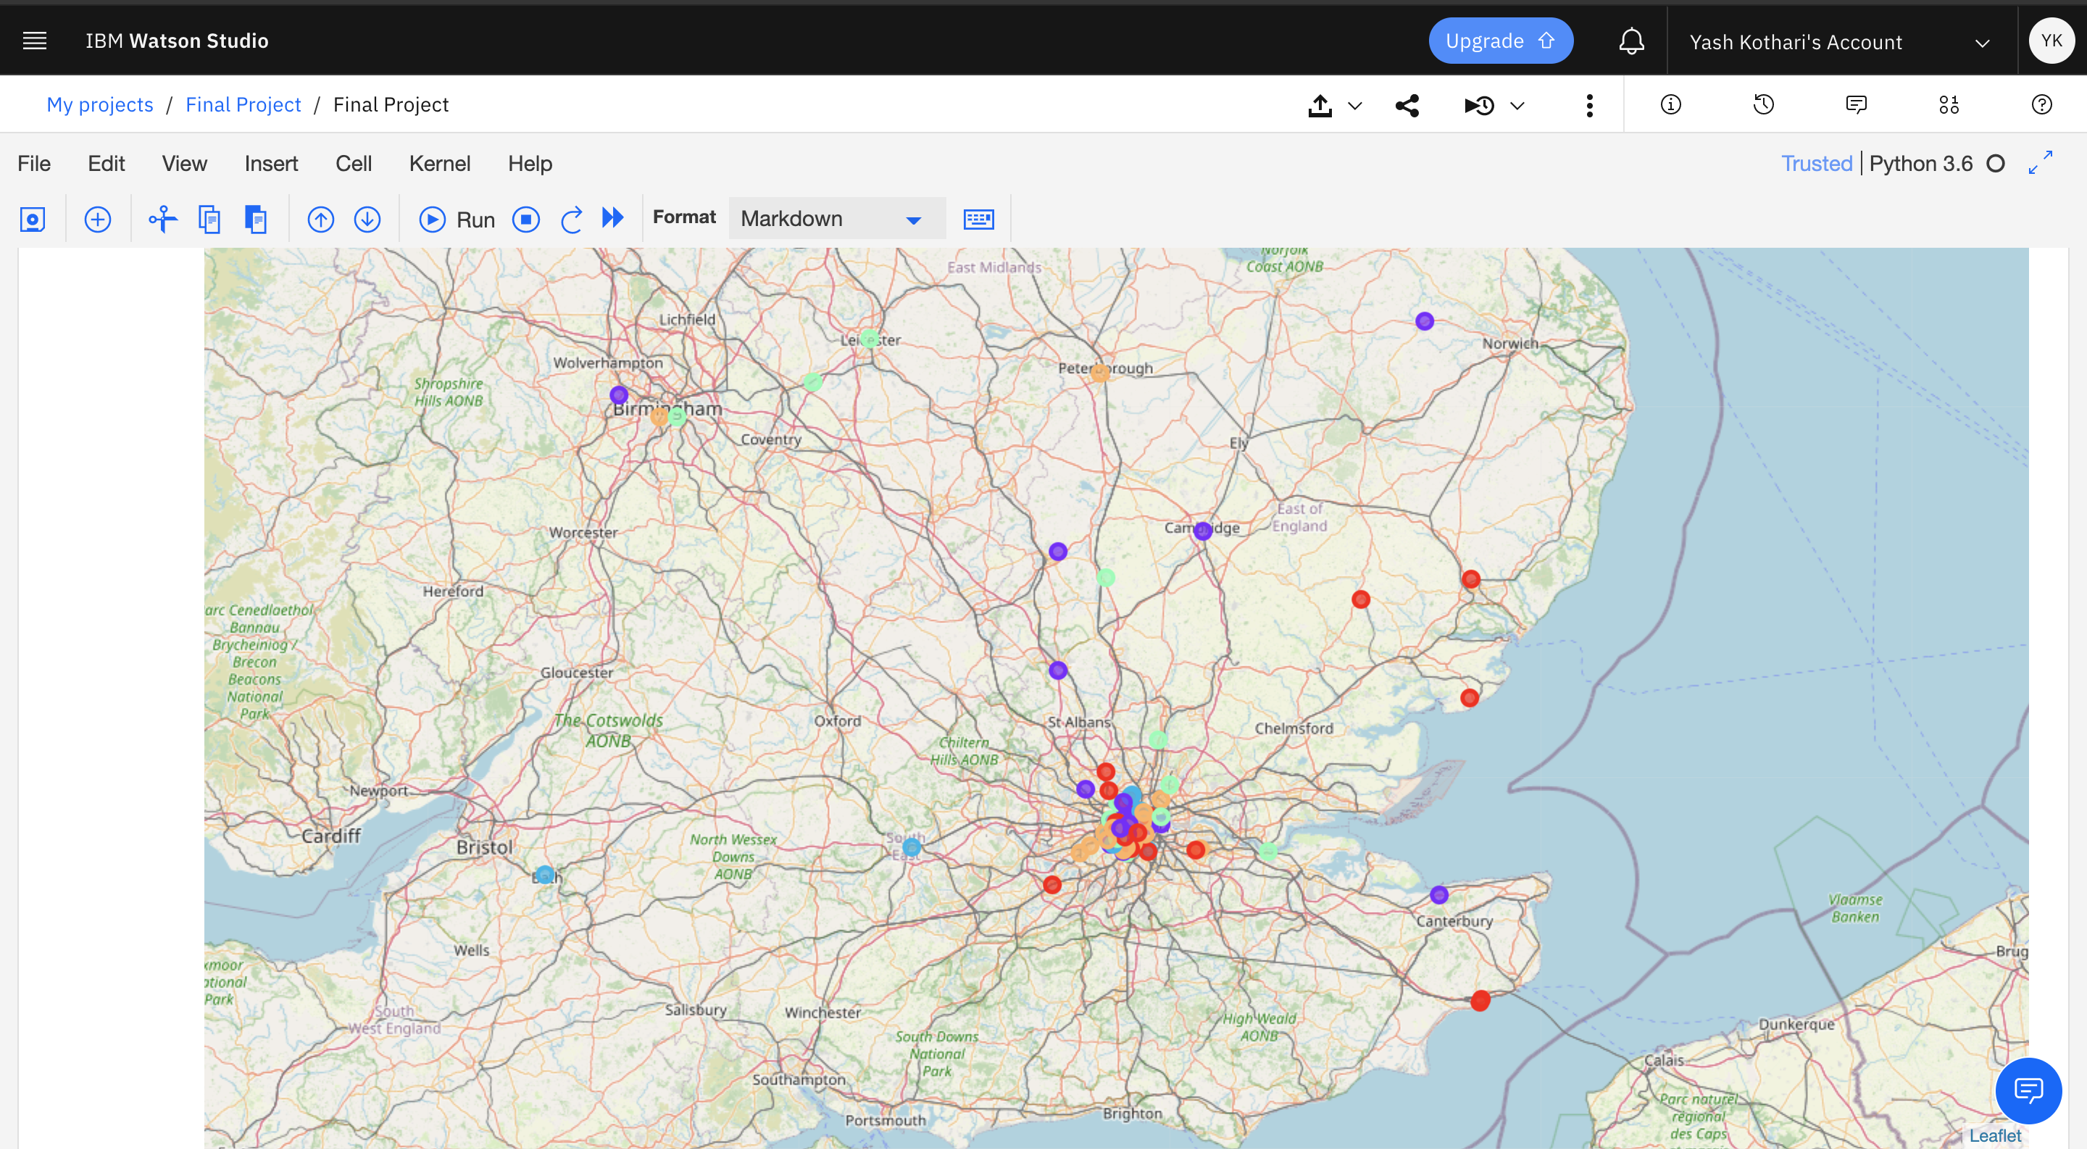
Clustering

Slide 6
Conclusion
West London (Notting Hill, Kensington, Chelsea, Marylebone) and North-West London (Hampsted) may be viewed as profoundly gainful scenes to buy a land as per comforts and fundamental offices encompassing such settings for example grade schools, secondary schools, medical clinics and supermarkets, South-West London (Wandsworth, Balham) and North-West London (Isliington) are emerging as next future tip top scenes with a wide scope of courtesies and offices. Likewise, one may focus under-estimated genuine homes in these territories of London so as to make a business undertaking. Second, we examined our outcomes as indicated by the five groups we created. While Clusters 0, 2 and 4 may target home purchasers inclined to live in 'green' zones with parks, waterfronts, Clusters 1 and 3 may target people who love bars, theaters and soccer.

